Slide 1
Sessions 3
Security Services
Security Mechanisms
A Model for Network Security

Slide 2
Security Services
Authentication - assurance that communicating entity is the one claimed
  have both peer-entity & data origin authentication
Access Control - prevention of the unauthorized use of a resource
Data Confidentiality –protection of data from unauthorized disclosure
Data Integrity - assurance that data received is as sent by an authorized entity
Non-Repudiation - protection against denial by one of the parties in a communication
Availability – resource accessible/usable

Slide 3
Security Mechanism
Encipherment
Digital Signature
Access Control
Data Integrity
Authentication Exchange
Traffic Pading
Routing Control
Notarization

Slide 4
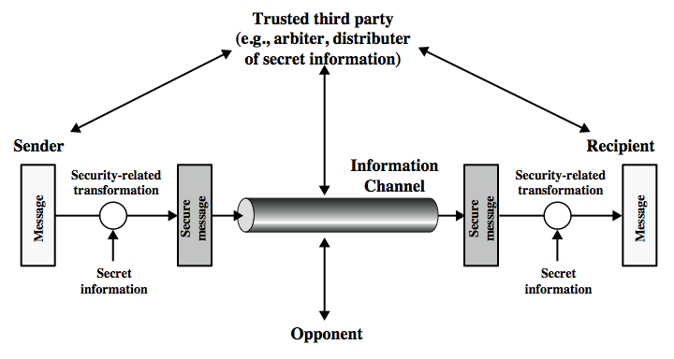
Model for Network Security

Slide 5
Model for Network Security
using this model requires us to:
  design a suitable algorithm for the security transformation
  generate the secret information (keys) used by the algorithm
  develop methods to distribute and share the secret information (key)
  specify a protocol enabling the sender and receiver to use the transformation and key for a security service

Slide 6
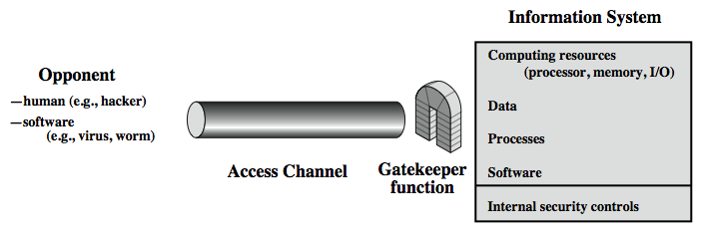
Model for Network Access Security

Slide 7
Model for Network Access Security
using this model requires us to:
  select appropriate gatekeeper functions to identify users
  implement security controls to ensure only authorised users access designated information or resources
note that model does not include:
  monitoring of system for successful penetration
  monitoring of authorized users for misuse
  audit logging for forensic uses, etc.

